Slide 1

An R Shiny app to present meta-meta-analysis results
Grace Skinner

Slide 2
Synthetic analysis
Use collated primary data to build models
Used for PREDICTS
Meta-analysis
Calculate effect size for each study
Effect sizes are weighted according to study size
Notes:
Synthetic analysis – Collect data from multiple papers that meet your criteria (collated primary data) – build models using this data. Used for PREDICTS analysis.
Meta-analysis – Collect data from multiple papers that meet your criteria. Calculate effect size for each study.
Effect size measures provide a standardized method for comparing results across different studies with similar designs.
They are weighted according to study size so larger paper given more bearing on results.
Each study may have multiple effects sizes.
Use the calculated effect sizes to find an average effect size across all the included studies. This takes into account the fact that effect sizes from the same study will be related in some way.

Slide 3
Premise of my project
Standardised protocol and data entry sheets
Filtering depending on hypotheses
Visualising the results = Shiny app!
Notes:
We are getting to the point where lots of meta-analyses are being completed and it would be good if we have a standardised way of analysing all these together in a meta-meta-analysis. So basically performing a meta analysis of meta analyses.
When people come to complete new meta-analyses, we need standardised protocols and data entry sheets in place.
We then need a way of filtering for different things depending on what you’re interested in / what your hypotheses are.
Finally, we need a way of visualizing the results, which is where the shiny app comes in.
The aim is to code the shiny app in such a way that it updates automatically when new meta-analyses are added.

Slide 4
Overview of process
Christina Raw Meta-meta-analysis
Scoping
Screening
Extraction
Cleaning
Analysis using robust models
Shiny app uses extracted model coefficients
Notes:
Christina Raw – performed a meta-analysis of meta-analyses to investigate the effect of different agricultural systems on biodiversity
Scoping – see what’s out there
Screening – assess which papers to include based on criteria
Extraction – filling in spreadsheet with relevant data
Cleaning
Analysis on log response ratios using robust models - to compare biodiversity in terms of log response ratio in different agricultural systems. Conventional agriculture is the reference level
I replicated the cleaning and modelling to end up with a table of extracted coefficients from the model
These are fed into the shiny app to graphically display the results

Slide 5
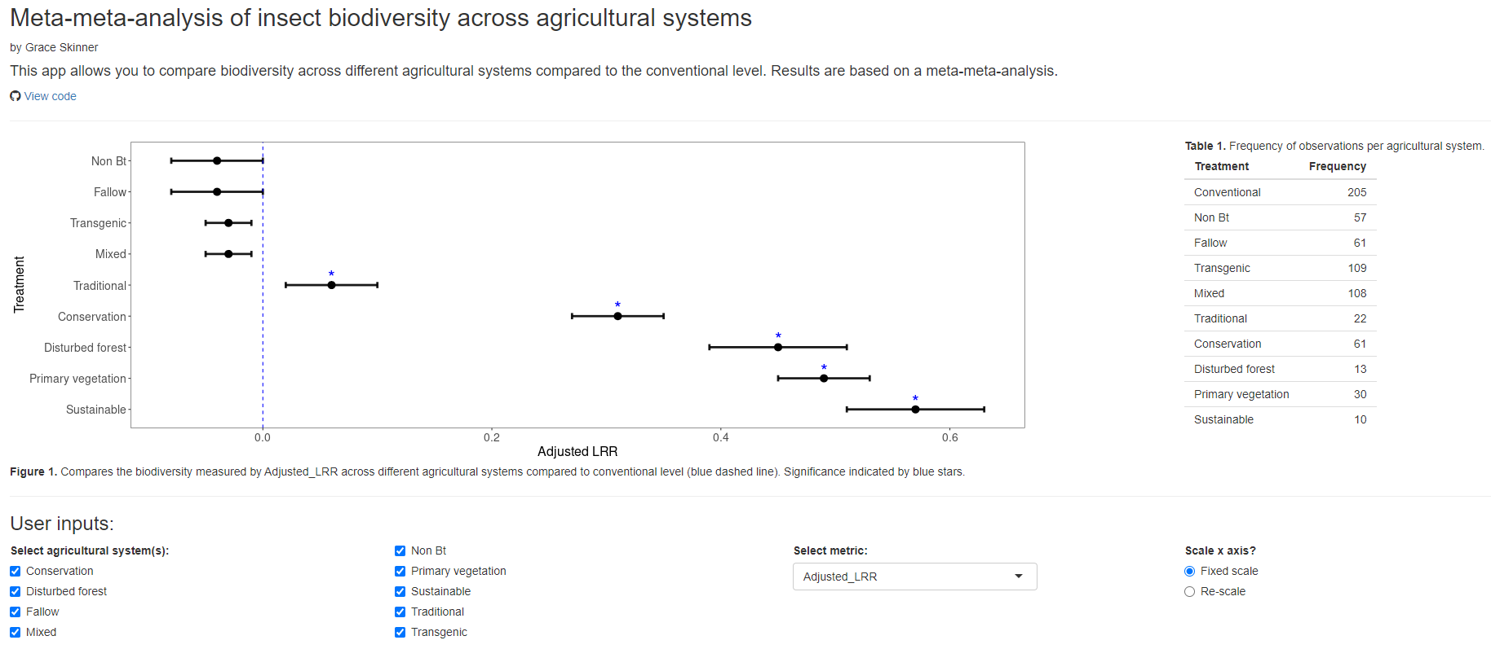
Shiny app demonstration
https://r26dnk-grace-skinner.shinyapps.io/meta_meta_analysis/
Notes:
Main graph which plots the results that the user wants to see. The agricultural systems are named on the y axis. The blue dashed line indicates the reference conventional agricultural system.
The agricultural systems which are significantly different to the conventional level have a blue star above them.
The user can choose which agricultural systems they would like to see displayed.
And the user can choose whether they want to plot log response ratio or percentage change on the x axis.
The user can also choose whether the re-scale the x axis as different agricultural systems are selected, or keep it fixed.
The app also displays a table of the number of observations of each agricultural system that the results are based on.

